Slide 1
The Grand Canyon
Jonathan Zarb

Slide 2
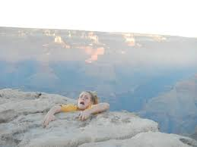
THE GRAND CANYON
The Grand Canyon is in South West, USA
It is a really big hole in near the Colorado River
If you fall off it you will die, but there is certain way to climb down.
The people who have climbed down and lived there.

Slide 3
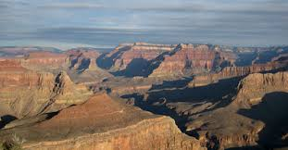
ENVIRONMENT
There are a lot of cacti and small bushes around the Grand Canyon
There is a lot of dirt and large rocks, driving up there is difficult

Slide 4
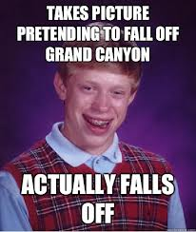
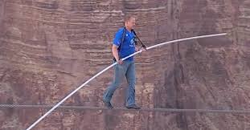
INTERCONNECTIONS
The Grand Canyon is a massive hole, so obviously it would attract tourists and dare devils.
It doesn’t serve much purpose.

Slide 5
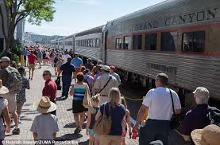
SUSTAINABILITY
It will never ever go away…
It brings in a lot of money to the workers there with people buying food, drinks and souvenirs.

Slide 6
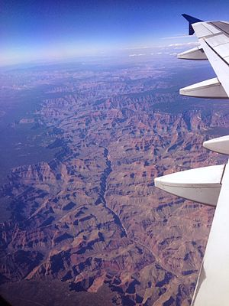
CHANGE
The Grand Canyon hasn’t changed in size or shape but has had a dramatic increase in tourism over the past decades.

Slide 7
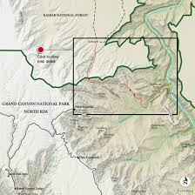

Slide 8
END

